Slide 1

Escalation straight-up: ESCALATION MANAGEMENT MODULE
Alabado, Matthew Arnold
Alconcel, Alanis Watz
Balubal, Samantha Nicole
Brillantes, Rachel Anne
Burton, Kathrine Danielle
Pamittan, Engel-Jan

Slide 2



INTRODUCTION
Escalation Module
Unattended service requests
Limited escalation process
Notes:
DANE: (Ikaw na po bahala sa introduction, basta ang gusto ni Sir Deeno, may engagement tayo sa audience start palang ng presentation. Kung paano yung ginawa nating nung nagpresent tayo ng mobile application natin sa kanya ☺ basta mas ok siguro kung you start with a question/s).
Eto pala yung content nung sa dating slides:
Client: Taal Vista Hotel
Problems:
Unattended service requests
Limited escalation process
Solution:
Escalation module

Slide 3
General OBJECTIVES
Develop a solution for Taal Vista Hotel that will produce effective escalation process

Slide 4

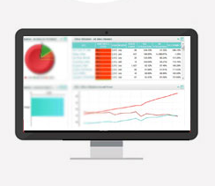

Specific OBJECTIVES
Notes:
Gather and analyze escalation data
Develop an Escalation Management Module
Generate reports to further improve quality management of the hotel

Slide 5

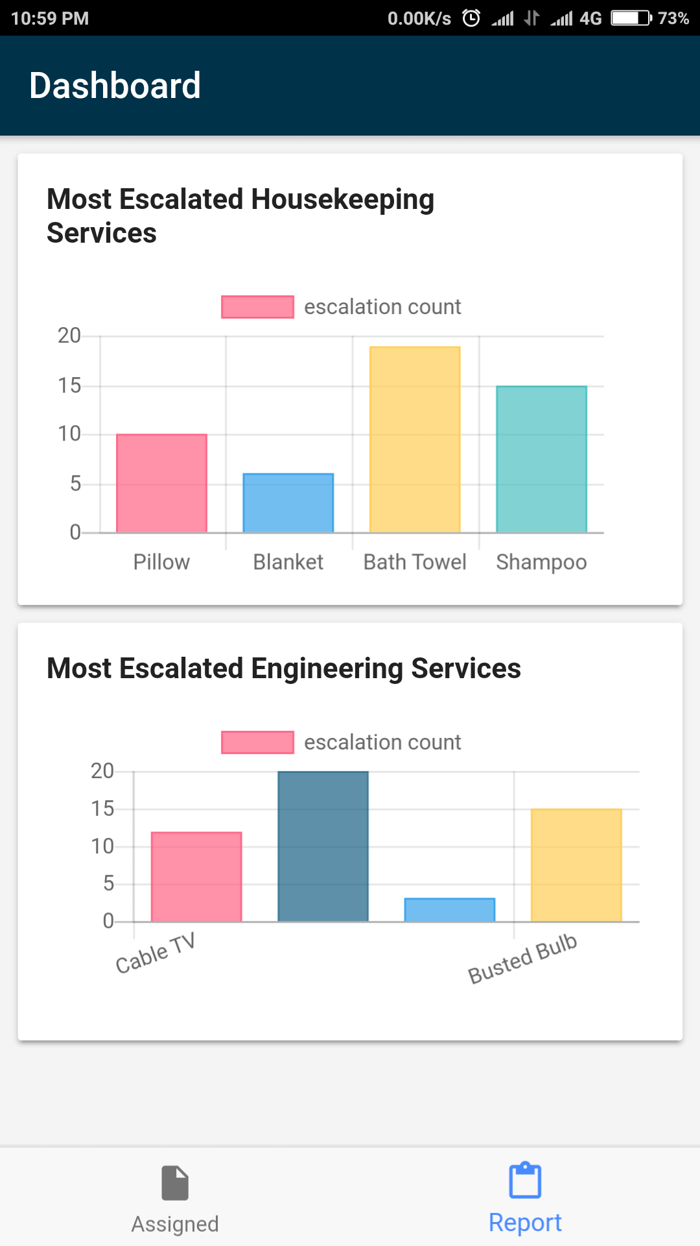
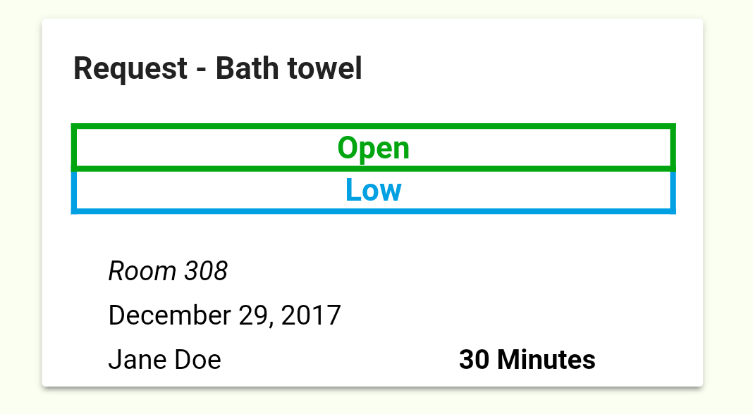
SCOPE
Notes:
Module will be initiated by an escalated service ticket
Generate escalation reports from data gathered on the escalation process.

Slide 6
SCOPE
Target Users:
4
2
1
3
General Manager
Resident Manager
Department Manager
Supervisor

Slide 7


LIMITATIONS
Notes:
Limited within the quality aspect of services
When the action needed on the service-related requests must be done by the expertise of a third party

Slide 8




Systems overview
Level 1: Supervisor
Level 2: Department Manager
Level 3: Resident Manager
Level 4: General Manager
Notes:
Receive: Unattended service tickets
Hierarchy Level:
Level 1 – Supervisor (SP)
Level 2 – Department Manager (DM)
Level 3 – Resident Manager (RM)
Level 4 – General Manager (GM)

Slide 9
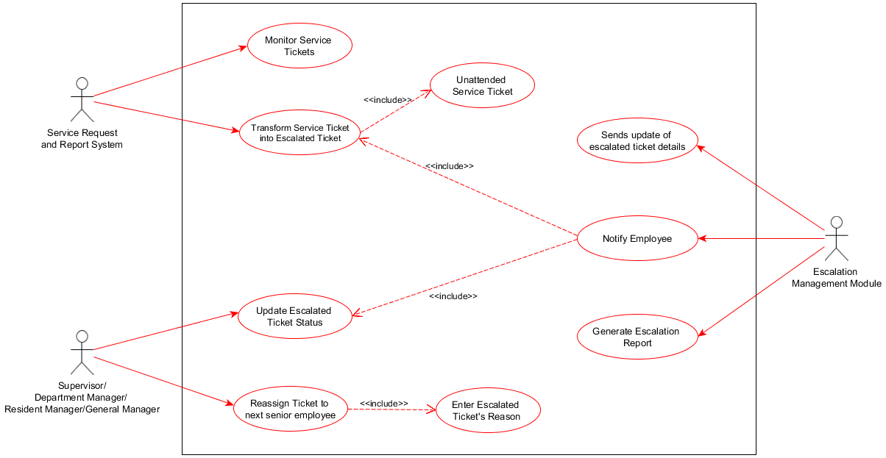
Use case
Notes:
Service request and report system is responsible for monitoring the service tickets and transform it into an escalated ticket. However, this process cannot be done without an unattended service ticket.
Once the unattended service ticket became an escalated ticket, the escalation management module notifies the Level 1 senior employee which is the Supervisor – the supervisor must update the escalated ticket status for it to considered by the module as an In-progress ticket and also to activate the timer. If the Supervisor failed to close the ticket and exceeds by the given time, it automatically notifies and re-assign the ticket to the next level of senior employee which is the Department Manager. Previous owners of the ticket must enter an escalated ticket’s reason.
Once the tickets closed, the module sends an update of escalated ticket details to the Service Request and Report System and generates an escalation report which displays a graphical representation of how many times a certain nature of service were escalated.

Slide 10
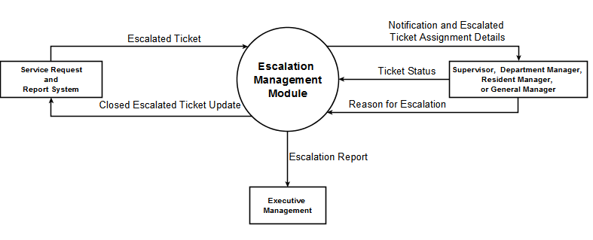
Context flow diagram

Slide 11
Escalation straight-up: ESCALATION MANAGEMENT MODULE

